Slide 1

Building & Mining Knowledge Graphs
(KEN4256)
Lab 6: Knowledge Graph Quality Assessment

Slide 2
KG Data Quality Assessment
Using Shape Expressions
Slides from http://www.validatingrdf.com/tutorial/iswc2018/

Slide 3
Shape Expression Language (ShEx)
a schema language for describing
RDF graph structures

Slide 4
Examples of Constraints
Match the datatype of a value
Literal should be a string
Value must be of specified shape
A person must have one property name of type string
Value must be an element of a set
A person must have two parents, one male and one female
Constraints
A person should never have a birth date after a death date

Slide 5
Shape Expression Language (ShEx)
Goal: RDF validation & description
Design objectives: High level, concise, human- readable, machine processable language
Syntax inspired by SPARQL, Turtle
Official info: http://shex.io and http://shex.io/shex-primer/

Slide 6
ShEx Example
Go to http://rdfshape.weso.es/validate
Shapes specification for a <User>
PREFIX : <http://example.org/> PREFIX schema: <http://schema.org/> PREFIX xsd: <http://www.w3.org/2001/XMLSchema#> :User IRI { schema:name xsd:string ; schema:birthDate xsd:date? ; schema:gender [ schema:Male schema:Female ]; schema:knows @:User* }

Slide 7
ShEx Example
:carol schema:gender schema:Female ; schema:name "Carol" ; foaf:name "Carol" . :alice schema:gender schema:Female ; schema:knows :bob ; schema:name "Alice" . :bob schema:birthDate "1980-03-10"^^xsd:date ; schema:gender schema:Male ; schema:name "Robert" .
:User IRI { schema:gender [ schema:Male schema:Female ]; schema:name xsd:string ; schema:knows @:User * }

Slide 8
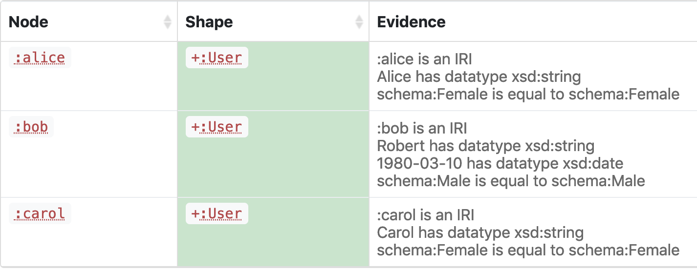
ShEx Example Results

Slide 9

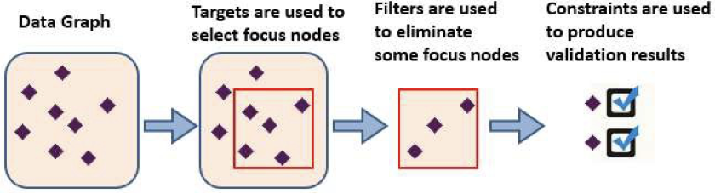
How does a Shape work?
Picture by Dimitris Kontokostas

Slide 10
ShEx Components
Shape Expression = labeled pattern
<label> {
… pattern ….
}
Shape Label
Shape Expression
:User IRI { schema:name xsd:string ; schema:birthDate xsd:date? ; schema:gender [ schema:Male schema:Female ]; schema:knows @:User* }
Notes:
Node and Triple Constraints
Triple format

Slide 11
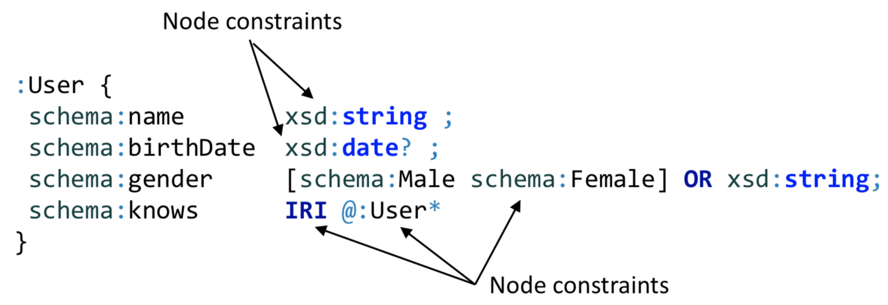
Node Constraints
Constraints over an RDF node

Slide 12
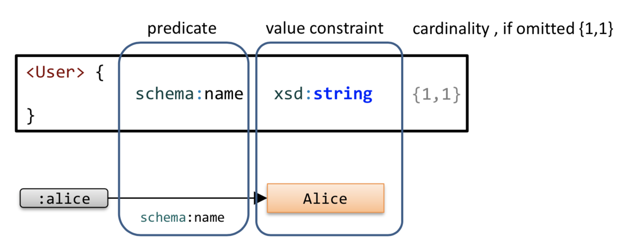
Triple Constraints
A basic expression consists of a Triple Constraint
Triple constraint ≈ predicate + value constraint + cardinality

Slide 13
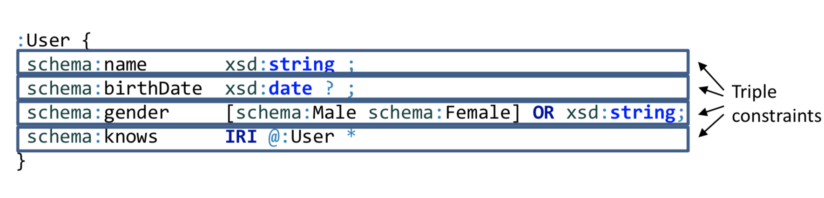
Triple Constraints
Constraints about the incoming/outgoing arcs of a node

Slide 14
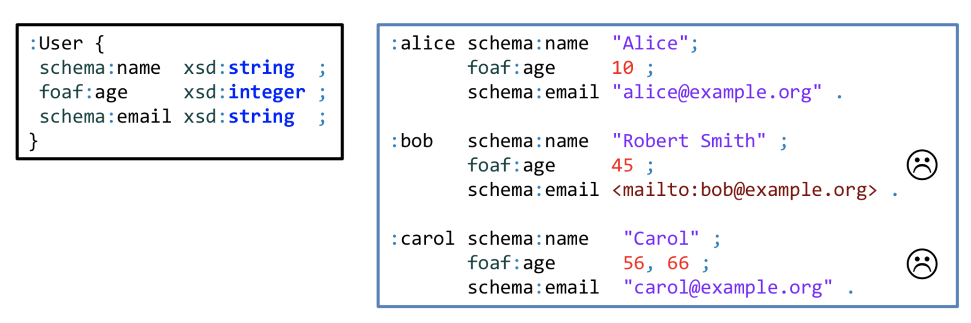
Simple expressions and groupings
The operator ; can be used to group components

Slide 15
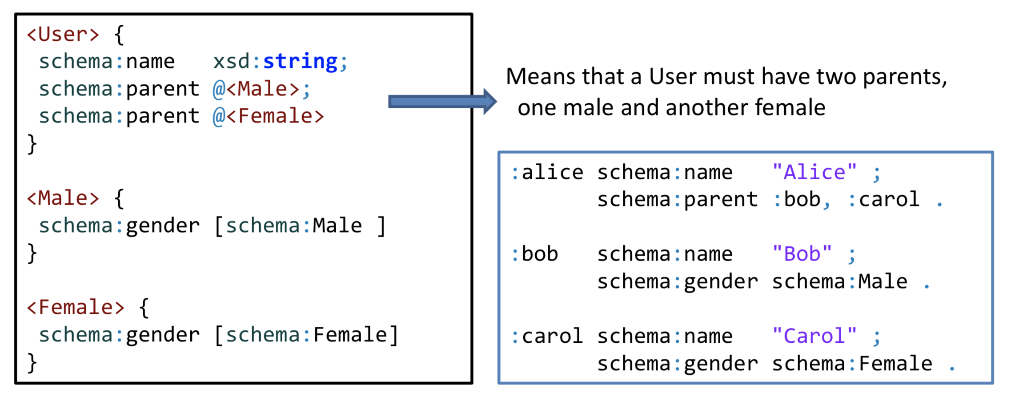
Repeated Properties
A repeated property indicates that each of the expressions must be satisfied

Slide 16
Cardinalities
* | 0 or more
+ | 1 or more
? | 0 or 1
{m} | m repetitions
{m, n} | Between m and n repetitions
{m, } | m or more repetitions
Inspired by regular expressions
Traditional operators: *, +, ?
plus cardinalities {m, n}
If omitted {1,1} = default cardinality

Slide 17
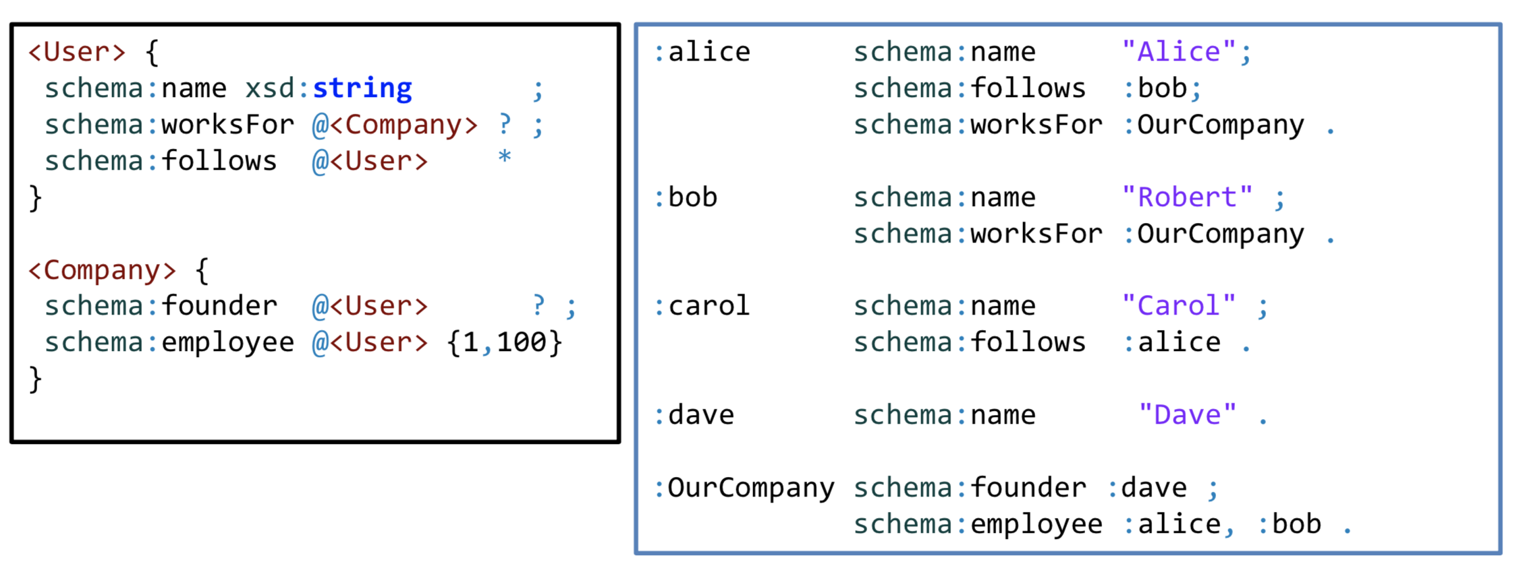
Example with Cardinalities

Slide 18
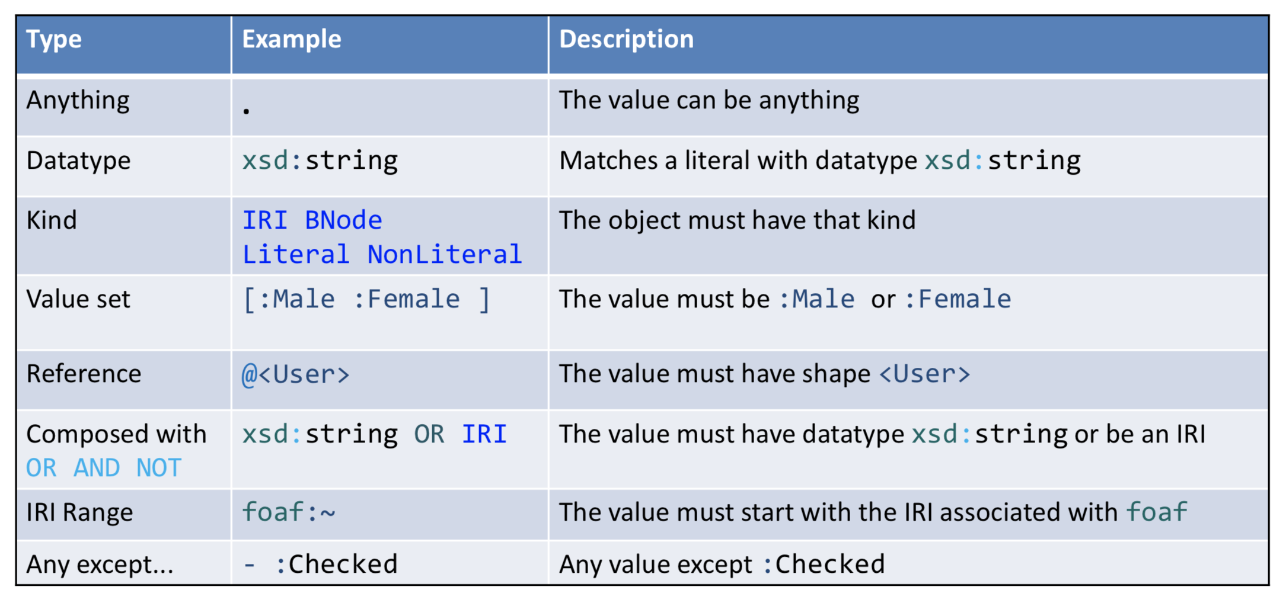
Value Expressions

Slide 19
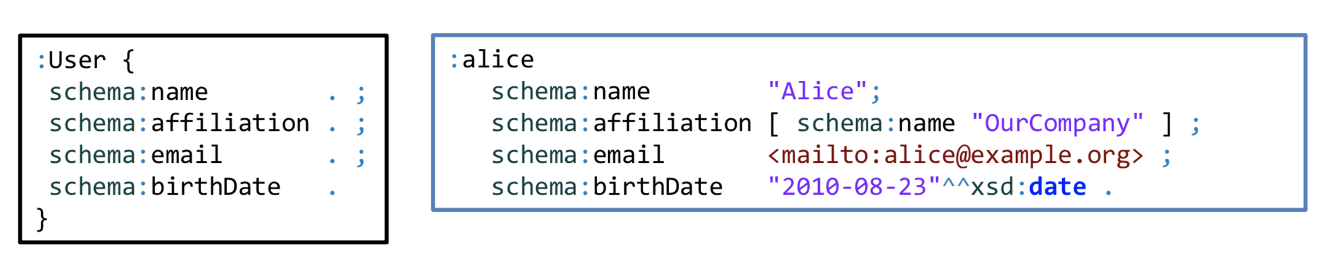
No Constraints

Slide 20
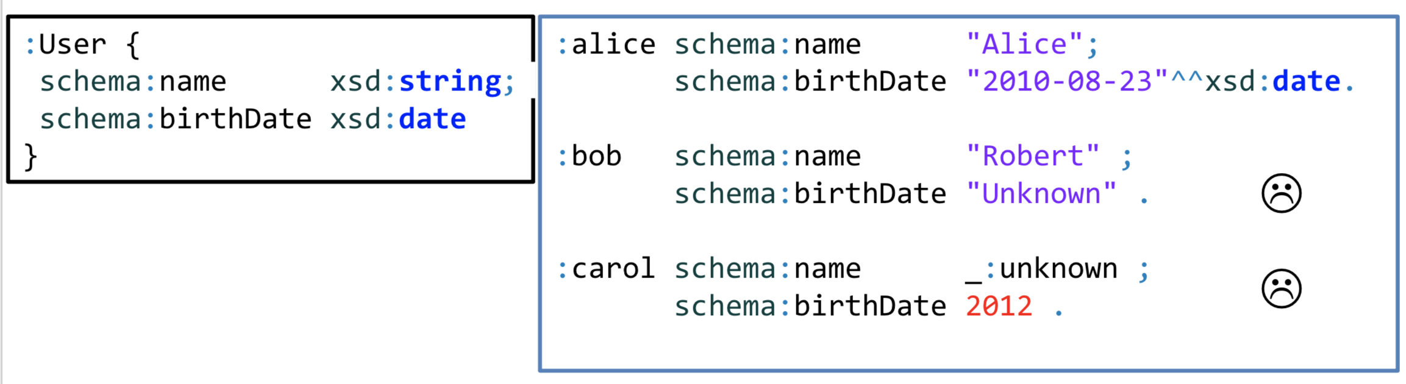
Datatypes

Slide 21
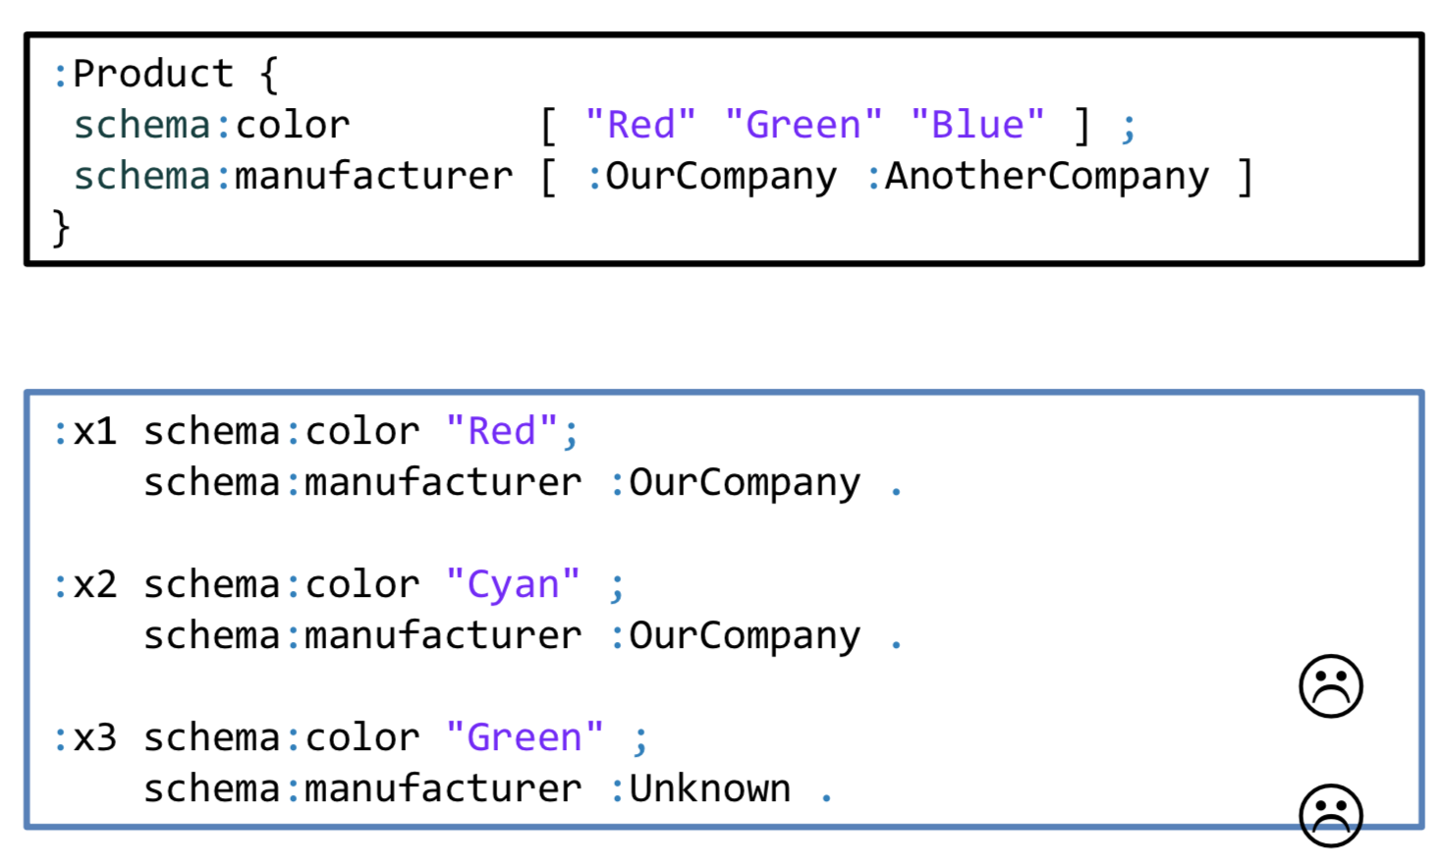
Value Sets
The value must be one of the values of a given set Denoted by [ and ]

Slide 22
ShEx Example
Shapes specification for a <User>
PREFIX : <http://example.org/> PREFIX schema: <http://schema.org/> PREFIX xsd: <http://www.w3.org/2001/XMLSchema#> :User IRI { schema:name xsd:string ; schema:birthDate xsd:date? ; schema:gender [ schema:Male schema:Female ]; schema:knows @:User* }

Slide 23
ShEx Example
Validator: http://rdfshape.weso.es/validate
:carol schema:gender schema:Female ; schema:name "Carol" ; foaf:name "Carol" . :alice schema:gender schema:Female ; schema:knows :bob ; schema:name "Alice" . :bob schema:birthDate "1980-03-10"^^xsd:date ; schema:gender schema:Male ; schema:name "Robert" .
:User IRI { schema:gender [ schema:Male schema:Female ]; schema:name xsd:string ; schema:knows @:User * }

Slide 24
ShEx Example Results

Slide 25
Questions?

Slide 26
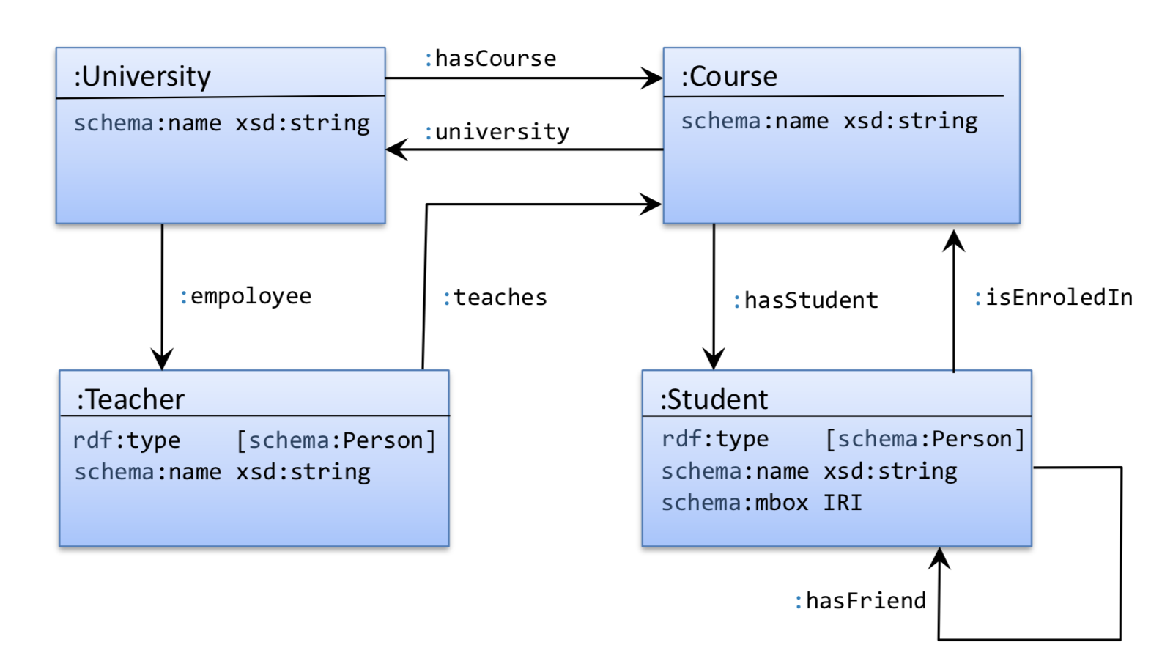
Exercise
:employee
http://rdfshape.herokuapp.com/validate
https://www.w3.org/2013/ShEx/FancyShExDemo
Start with https://tinyurl.com/y65cabyk
Notes:
Answer https://tinyurl.com/y4mghmc4

Slide 27
Resources
Quality Assessment for Linked Data: A Survey
http://www.semantic-web-journal.net/content/quality-assessment-linked-data-survey
Validating RDF Data Book:
http://book.validatingrdf.com/
Validating RDF Data Tutorial:
http://www.validatingrdf.com/tutorial/iswc2018/

